Slide 1
Program Elegantly
FacePrint Example

Slide 2
Program Elegantly:
Choose Appropriate Names, Formats & Styles
Reveal Intentions and Computing Structures Visually
Make Simple Things Simple
Write Readable/Understandable Code
Look at a series of PrintFace Example Code:

Slide 3
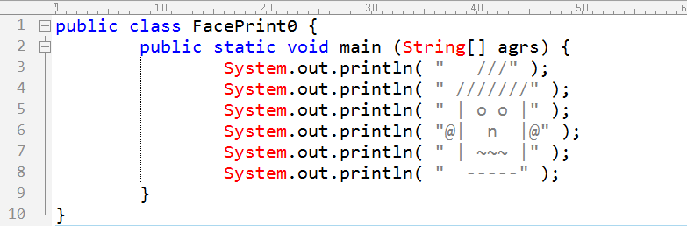
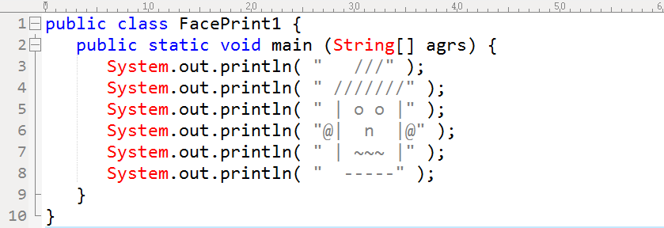
Researches Showed that 2~4 blanks are best readable indentations!

Slide 4
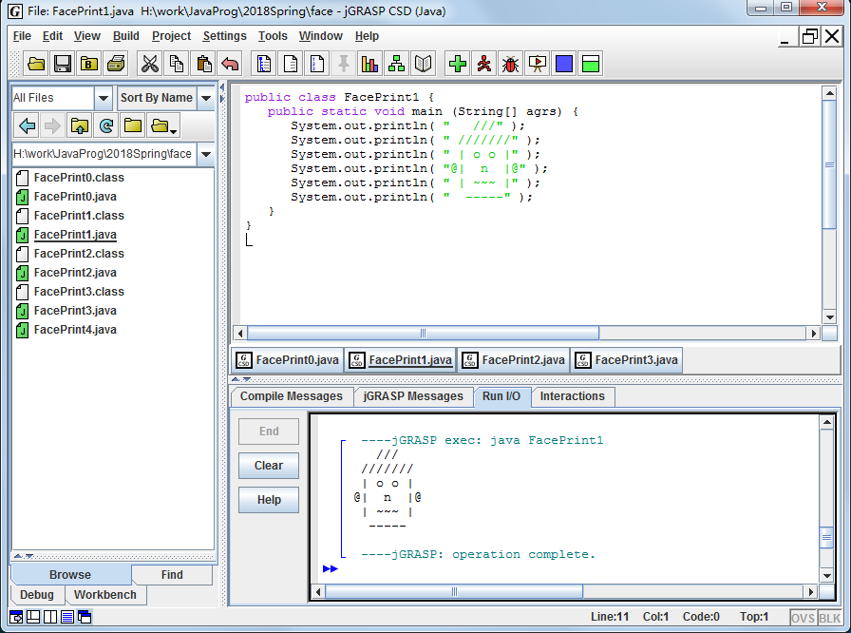

Slide 5
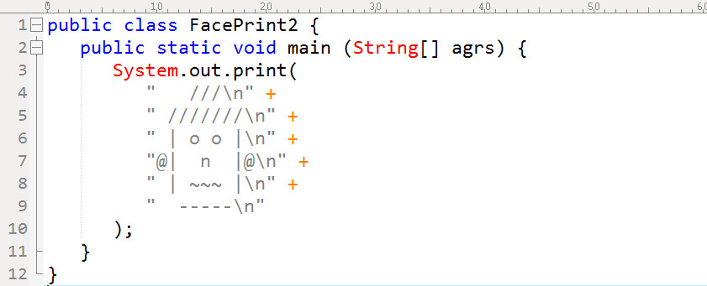
Remove Duplications whenever possible.

Slide 6
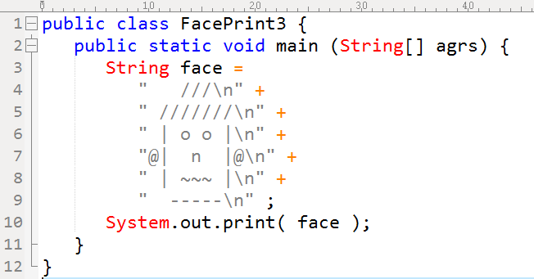
Naming something by a variable helps understanding.

Slide 7
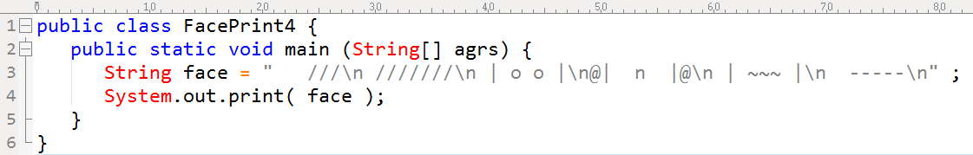
Programming for Humans First, Then for Compilers.

Slide 8
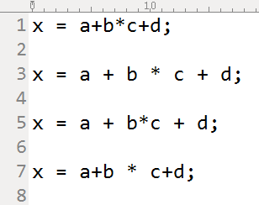
Crowded, Bad
Clear, Good
Creative, Best
Confused, Worse
Let the code speaks itself.
The Layout Structure of code reveals the Motivations / Logic Structure / Meaning Group (代码布局结构揭示计算的意图/逻辑结构/意群结构)
Help to understand and debug , 节省思维

Slide 9
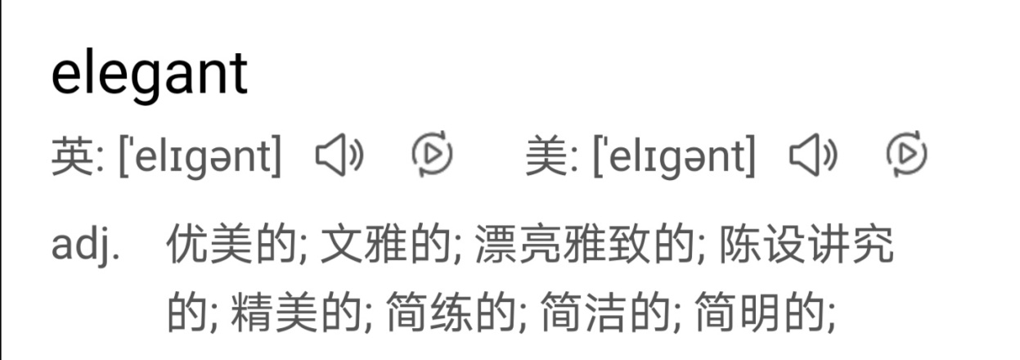
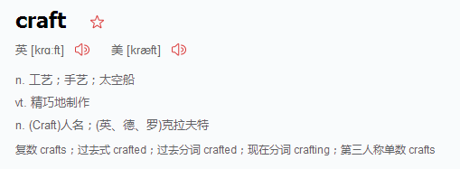
Elegant Programming 简明/优雅地编程
← 从后往前读
精心设计制作

Slide 10
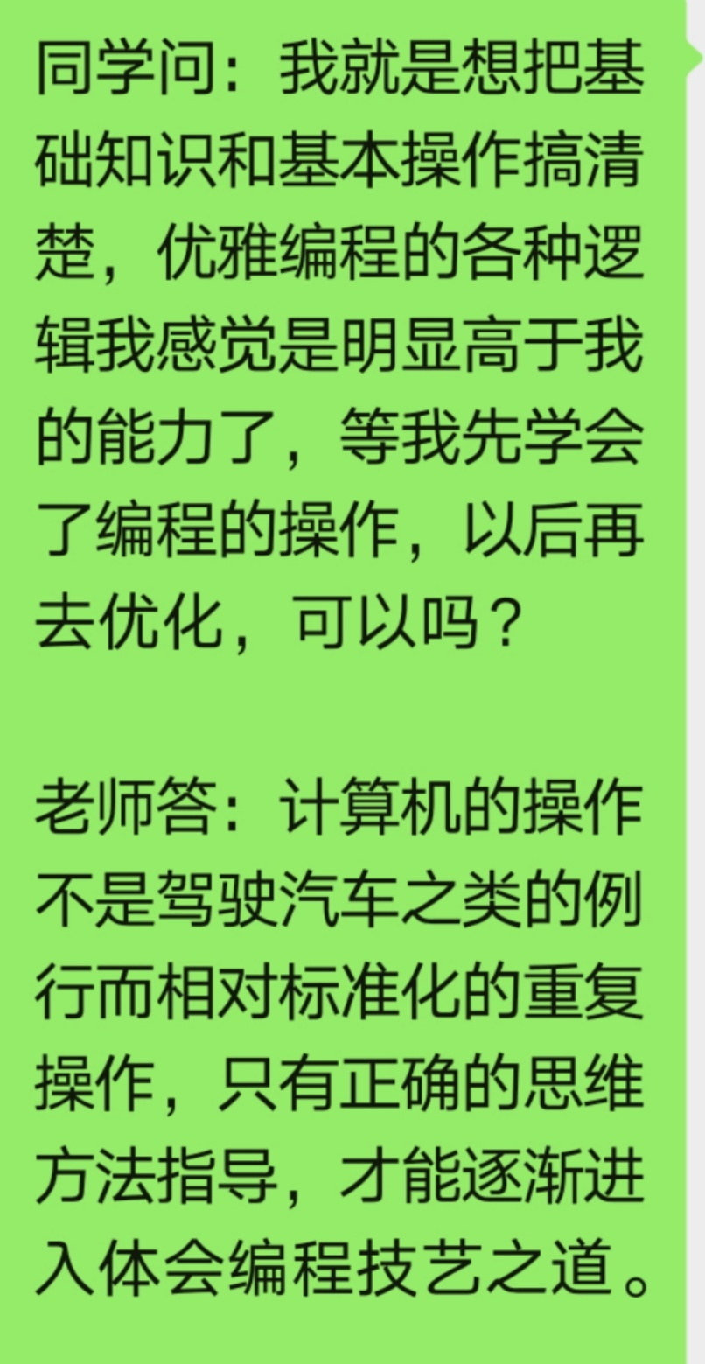
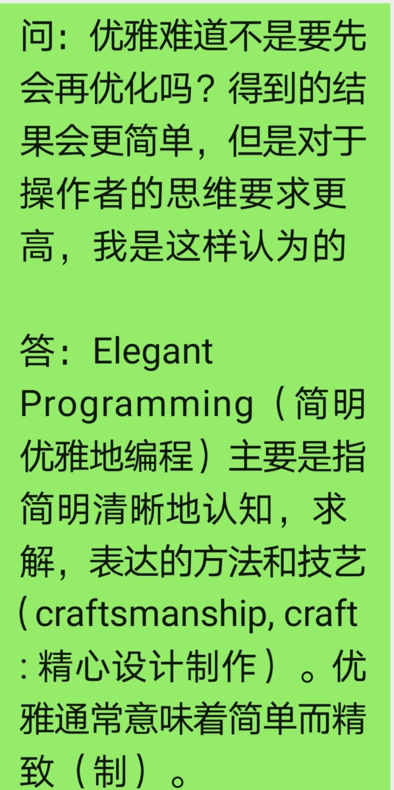

Slide 11
Program Elegantly:
Choose Appropriate Names, Formats & Styles
Reveal Intentions and Computing Structures Visually
Make Simple Things Simple
Write Readable/Understandable Code

